Slide 1

Enhanced QRCode Based Library Management System Github link:https://github.com/Teja Jambuluru/Enhanced-QRCode-based-Library-Management-System-B9-2021
Batch No: B9 Project Guide:
J.TEJA(174G1A0597) Dr. C.Sasikala M.Tech,Ph.D
K.SRAVANI(174G1A0589) Associate Professor
P.VIJAY KUMAR (174G1A05B3)
S.ZAIBA SULTHANA (174G1A05B7)
Srinivasa Ramanujan Institute of Technology
Department of Computer Science & Engineering

Slide 2
Abstract
Generally library plays a major role for every educational institution. Our main aim to develop smart library management system using QRCode.
Library Auditing is a useful information management tool to improve library services. Auditing is done by the employees manually which requires much time to count books, large in number. By this method they will be getting health issues too.
This method is much complex and requires more manpower
for auditing of books.The result may not be accurate.

Slide 3
Continued…
Application is developed by using Android studio and it contains a QRCode Scanner which scans the QRCodes on the books . By these we will get the report in the excel sheet containing the missing books
We are adding new features to the application , that if we scan a QRCode which is sticked to outside of library then we will get details of books and other related information which are present within library.If any QRCode damages,then we generate a new QRCode within an application and it will saved in our gallery.To note an important information we have add an information that store data permanently in our application.

Slide 4
Contents
Existing System
Proposed System
Literature Survey
Planning
Design
Implementation
Module Description
Execution and Results
Conclusion
References

Slide 5
Existing System
Auditing of books within a library is done manually within an organisation.
They need to keep their efforts and search each and every book and note the status of books whether it is issued or return and finalized the result.
We think that these method is much complex and results may not be accurate

Slide 6
Proposed System
QRCode generation is done by using UIPath,Automation tool.
Details of books is stored in firebase database.
To scan the books we are developing an application using Android Studio.
Continuous scanning of books is done.
Finally we will get the details of missing books within excel sheet.
Additionally,we are sticking QRCode outside of library if we scan it the details of books,librarians and related information can get in excel sheet.

Slide 7
Problem Definition
Generally auditing is done by using pen and paper .It is a time consuming process , the employees may suffer with health issues and the result may not be accurate.
We are developing an android application,where managing of issuing and returning of books is done. For doing it we are having two modules,Employee and Admin.Employee has access of scanning books continuously where as Admin has only access of issuing and returning of books.

Slide 8
Literature Survey
[1]U.Narmadhaa , P. Pavithra, M.Tharuneswari , S. Sowmiya, Nagarajan. “Enhanced QR-code based application for library management system using android”. International Journal on Applications in Information and Communication Engineering Volume 3: Issue 1: February 2017, pp 46-49.
Concluded:A QR code consists of black squares arranged in a square grid on a white background, which can be read by an imaging device such as a camera, until the image can be appropriately interpreted. The required data is then extracted from patterns that are present in both horizontal and vertical components of the image

Slide 9
Continued..
[2]Lambodara Parabhoi, Nivedita Bhattacharjya, Rupashree Dhar “Use of QR Code in Library” researchgate.net/publication/318259063 January 2017 Concluded: Libraries are now being very challenged by the development of various technologies. In this present era, the new technology like QR code demands the changes of information handling in the library. The user would have easy access to most current and necessary information related to the library by using QR code.

Slide 10
Planning
Required time to complete the task | Task
Week 1 | Installation of Java JDK and Android Studio.Should learn basic concepts of android and its latest versions
Week 2 | QRCodes are generated and then by using application will scan it and implement it in a practical way.
Week3 | Adding new features to the existing project like adding a screen resolution ,mentioning employee taken books and issued date also.
Week4 | Report generation
Week5 | Testing and validation
Week6 | Document submission

Slide 11
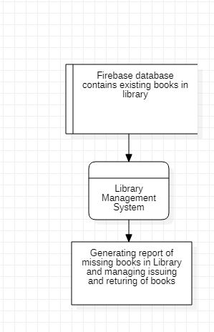
Design
DataFlow Diagram
Level-0

Slide 12
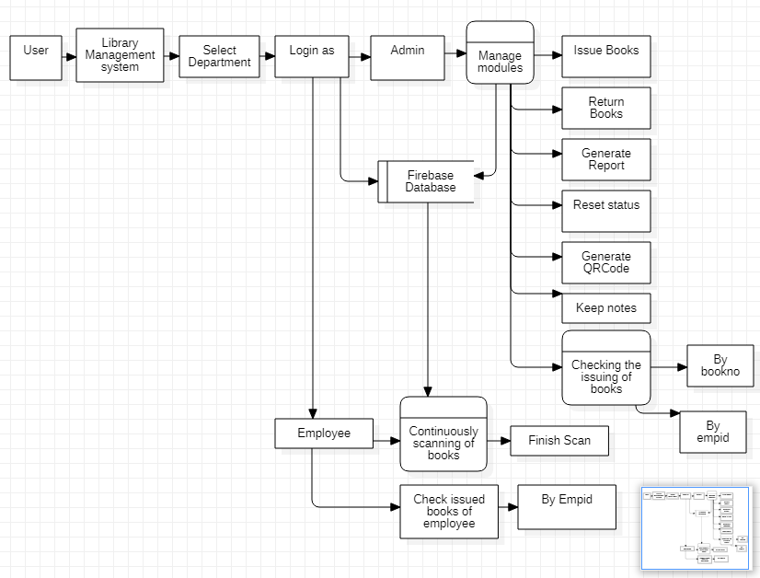
DFDLevel-1

Slide 13
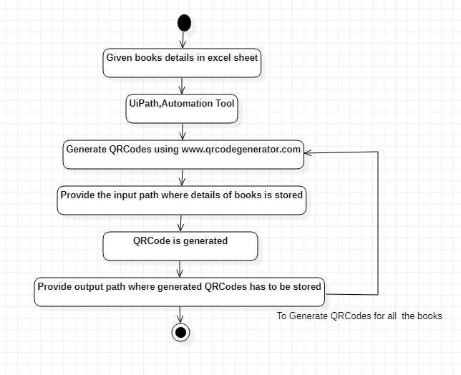
Activity Diagram

Slide 14
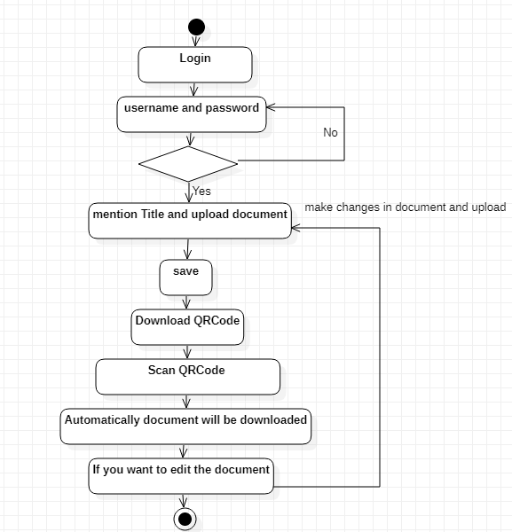
Activity Diagram

Slide 15
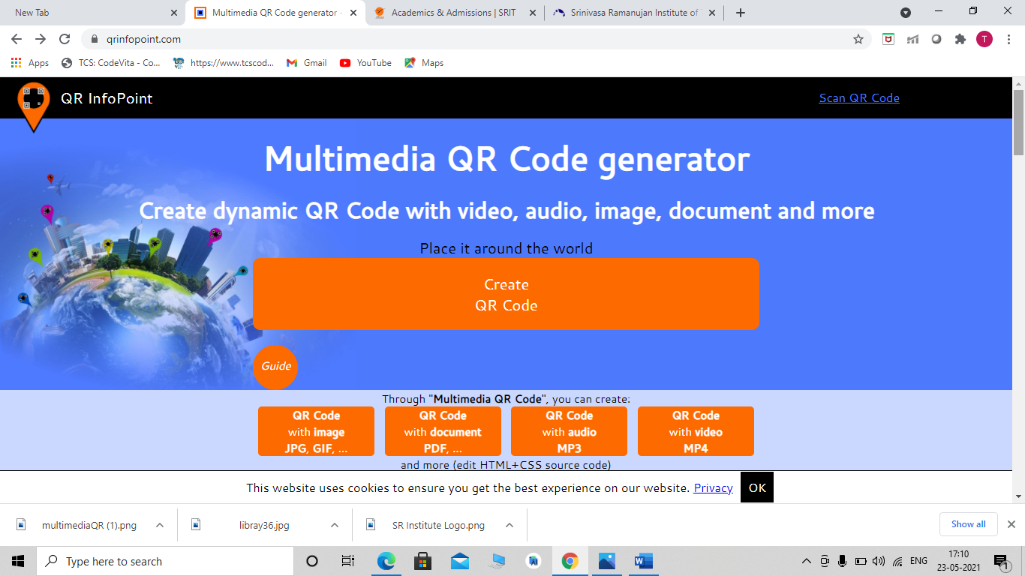
Implementation

Slide 16
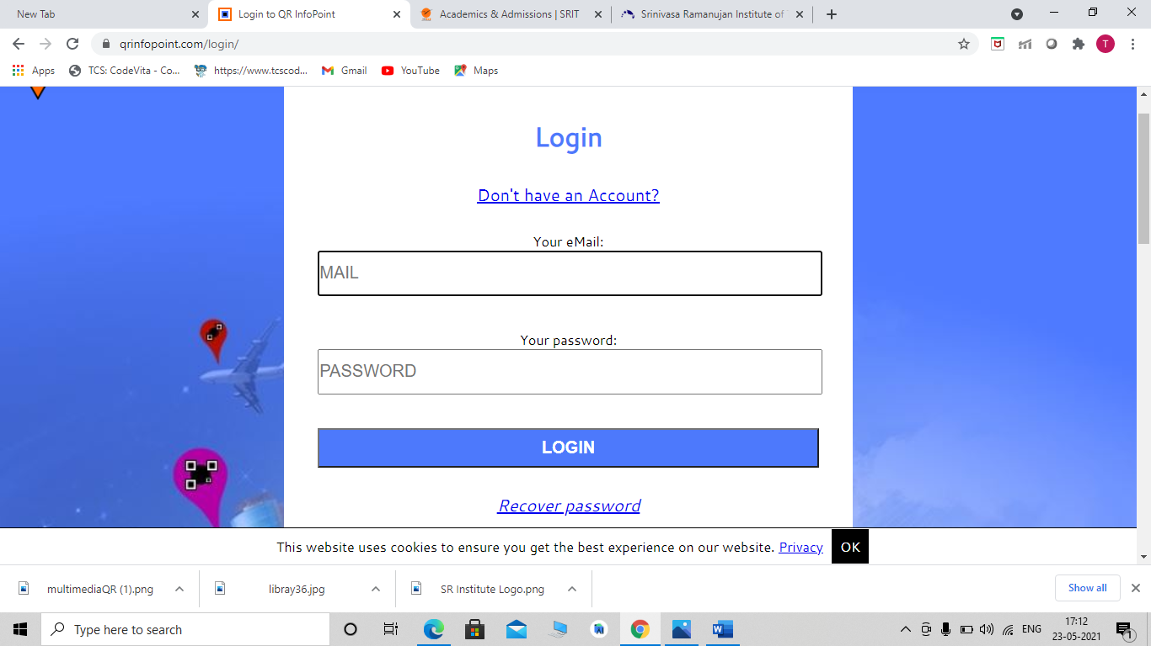
Login Details

Slide 17
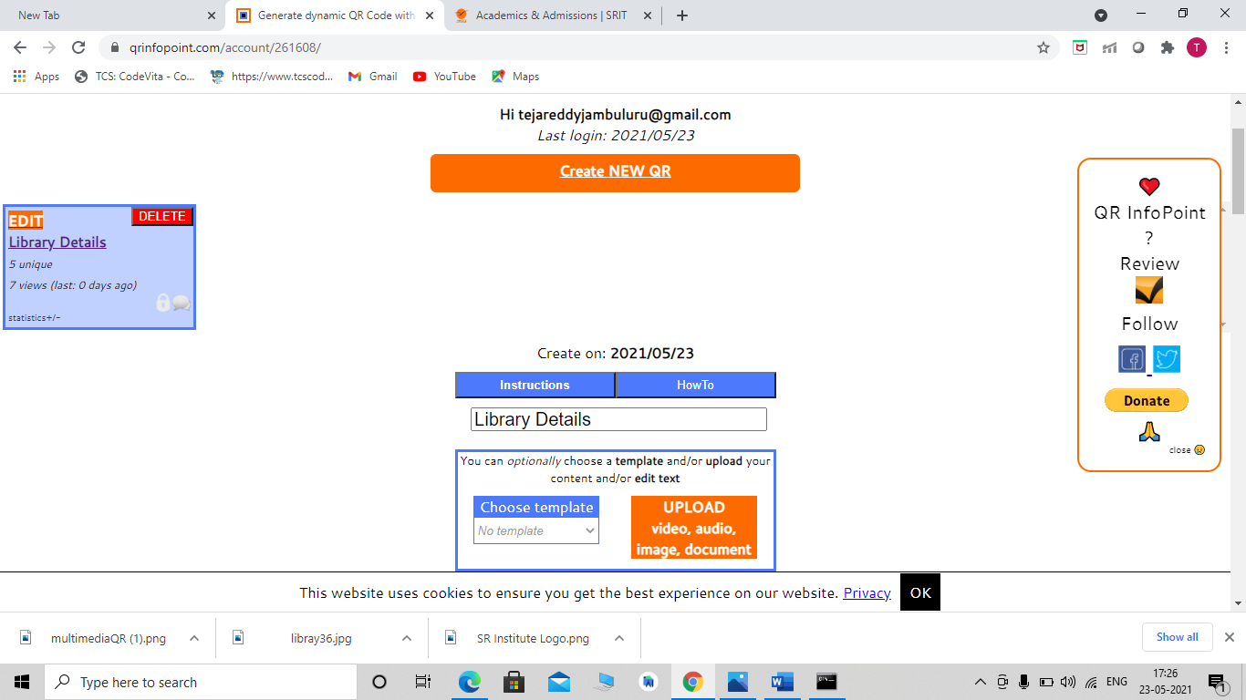
Continued..

Slide 18
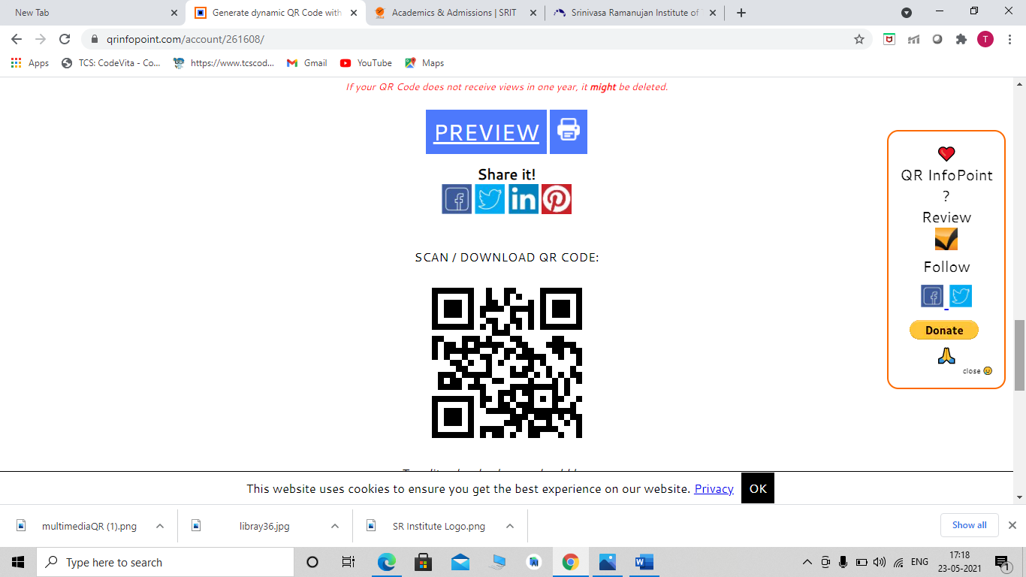
Continued..

Slide 19
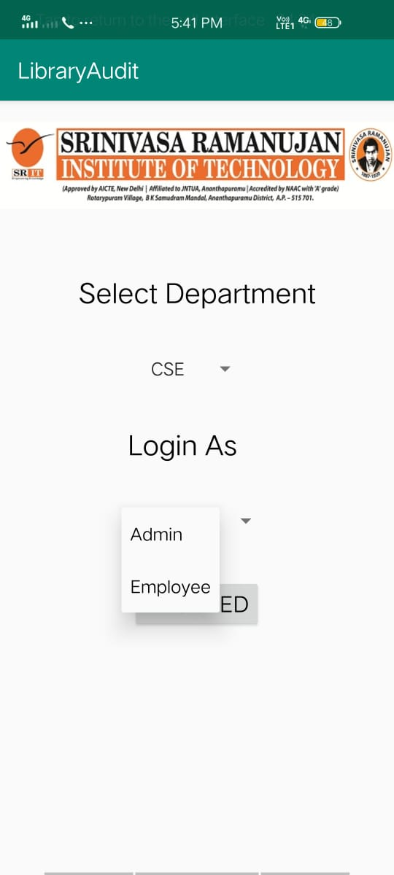
Module Description
In our application it consists of two modules.
Employee Module
Admin Module

Slide 20
Employee Module
In this module, we are scanning books continuously and book number will be displayed if we scan a particular book.
Employee can take the books and check the status of books by using their Emp Id.
If new employee wants to use these application,the employee should have an authorized username and password.

Slide 21
Admin Module
The main functionality of application to retrieve the missing books in the Excel sheet After Auditing .
Additionally admin has the Access to issue the books that don’t exceed five, returning of books by scanning QRCode or book number printed on each book.
Admin can use reset button to clear the scanned status of books in the database.
Admin can able to check the issued books with BookId or EmpId
Admin can note important information and that is stored permanently in application.
We want to generate QRCodes for two or three books we can generate it within application and stored in gallery.

Slide 22
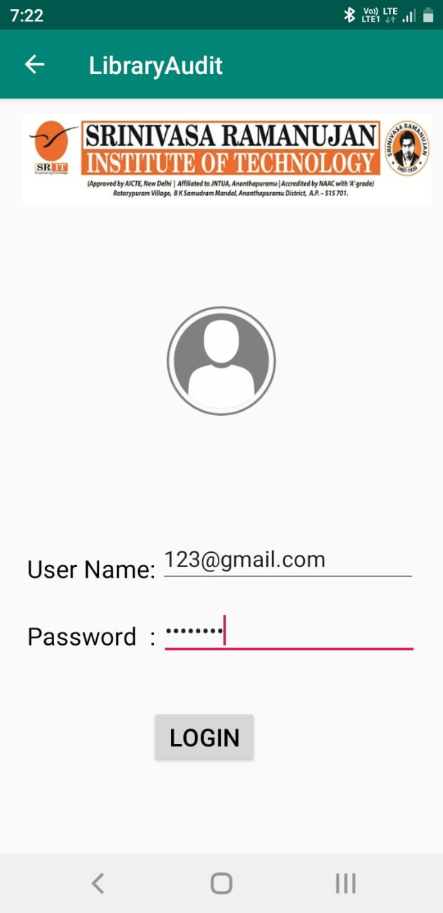
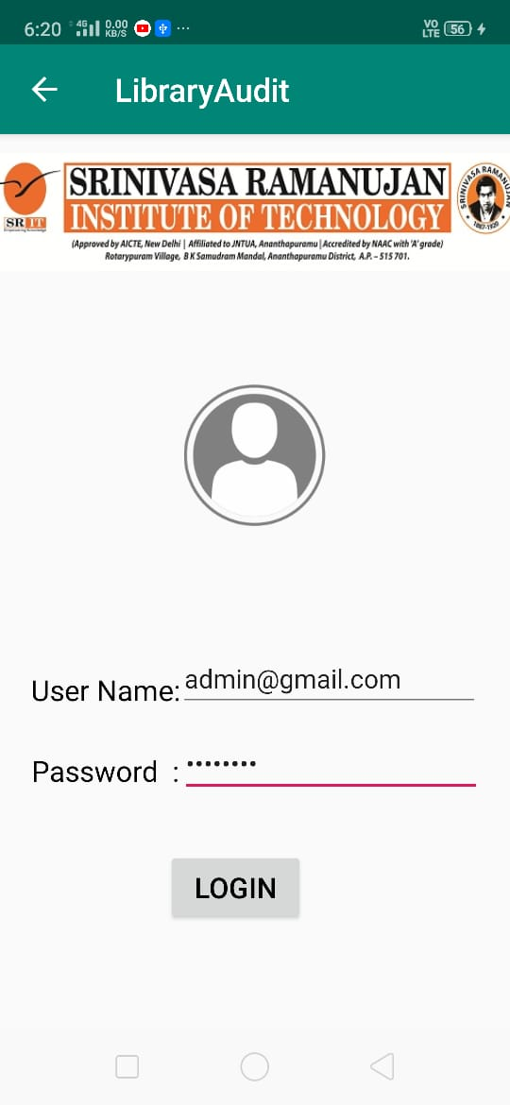
Execution and Results
Login screen for Employee and Admin

Slide 23
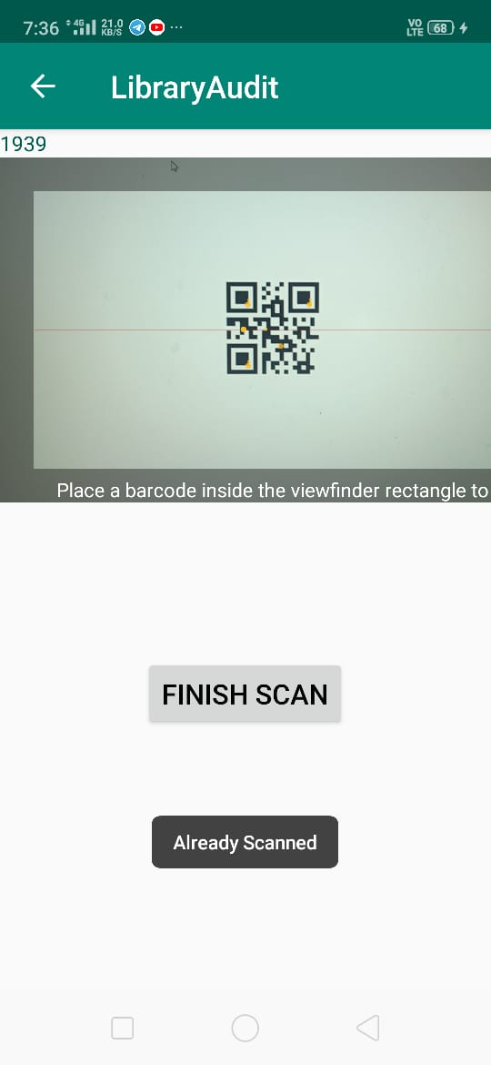
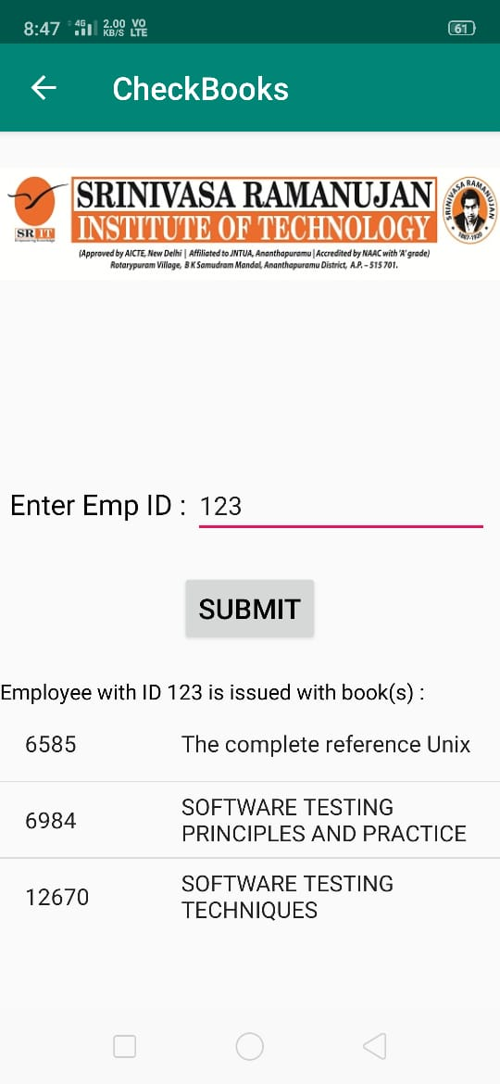
Employee Module Execution
Employee has only access to Scanning
of QRCodes Printed on Books

Slide 24
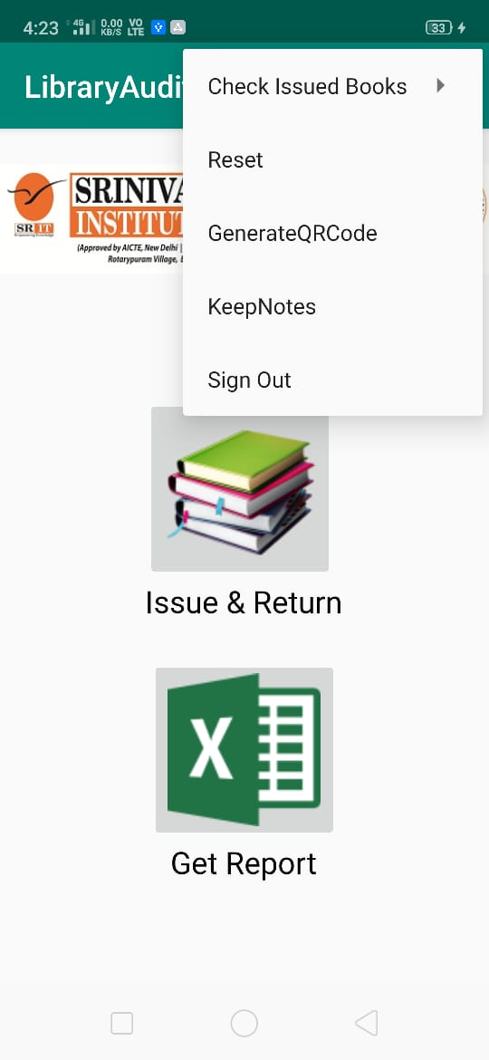
Snapshot of Admin Module

Slide 25
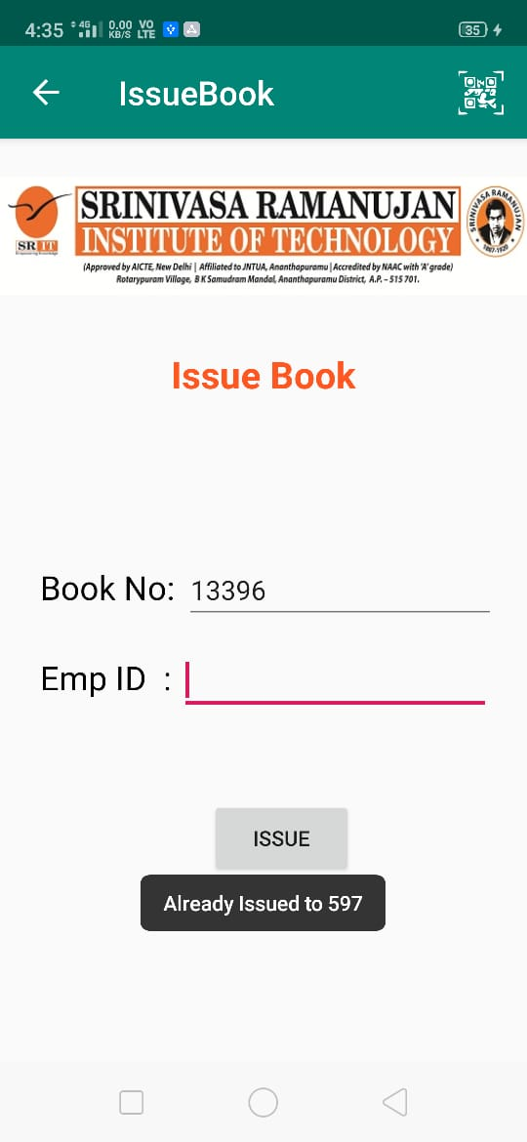
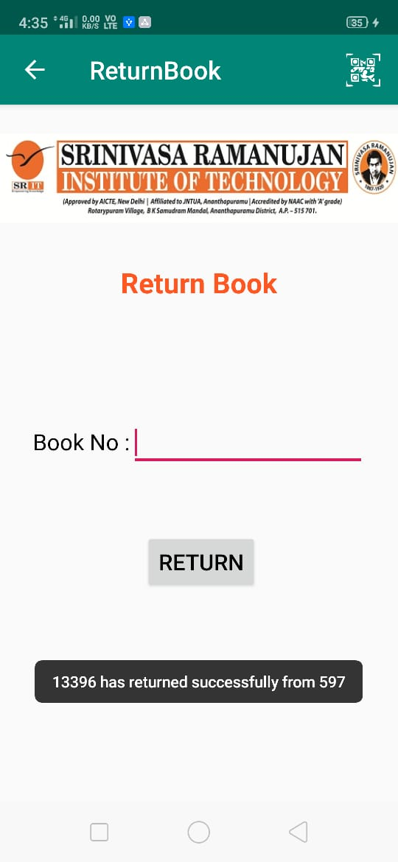
Issue and Return of books

Slide 26
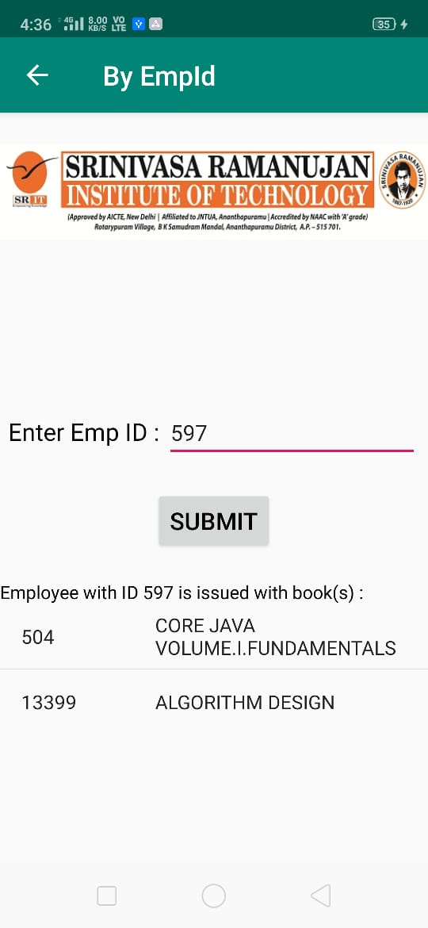
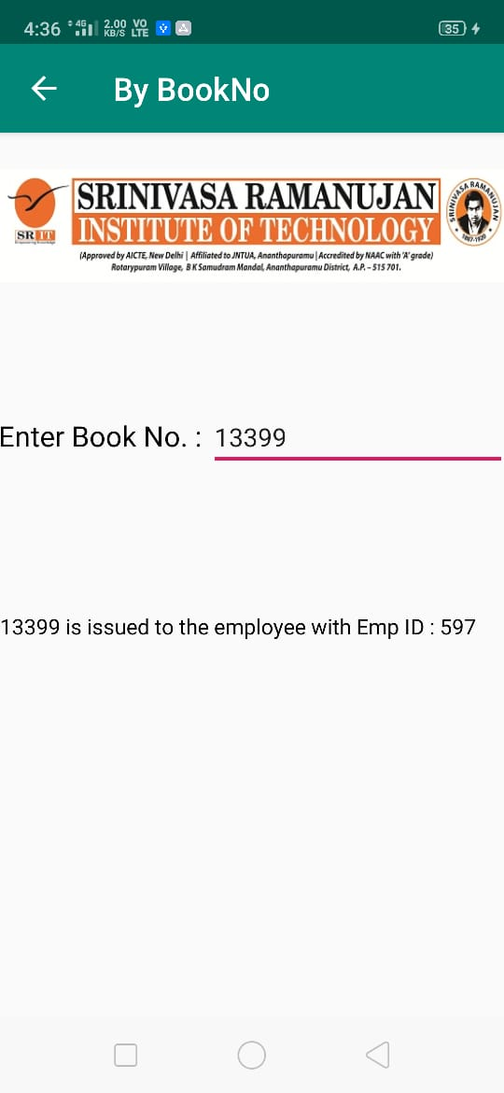
Check Issued books By EmpId or BookNo

Slide 27
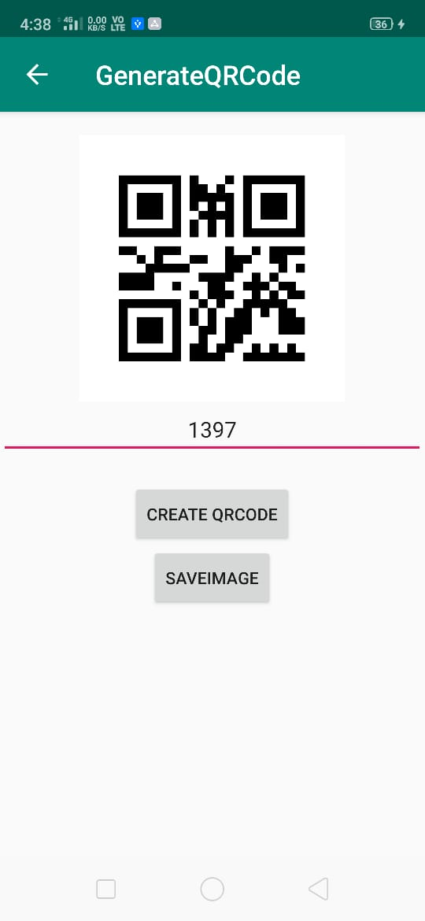
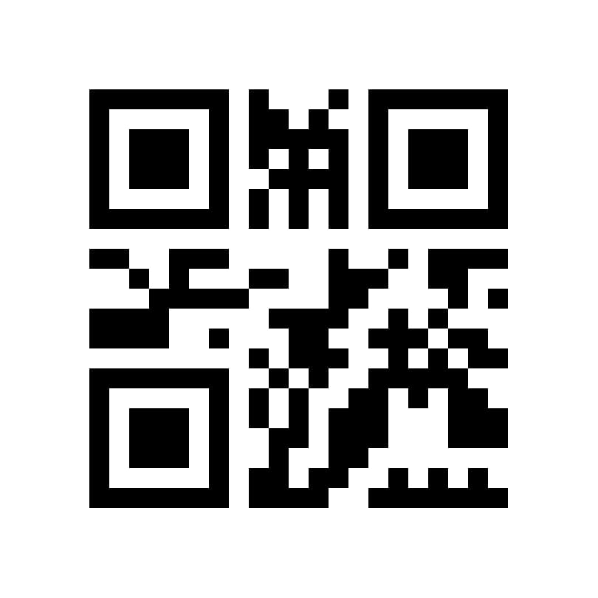
Generate QRCode

Slide 28
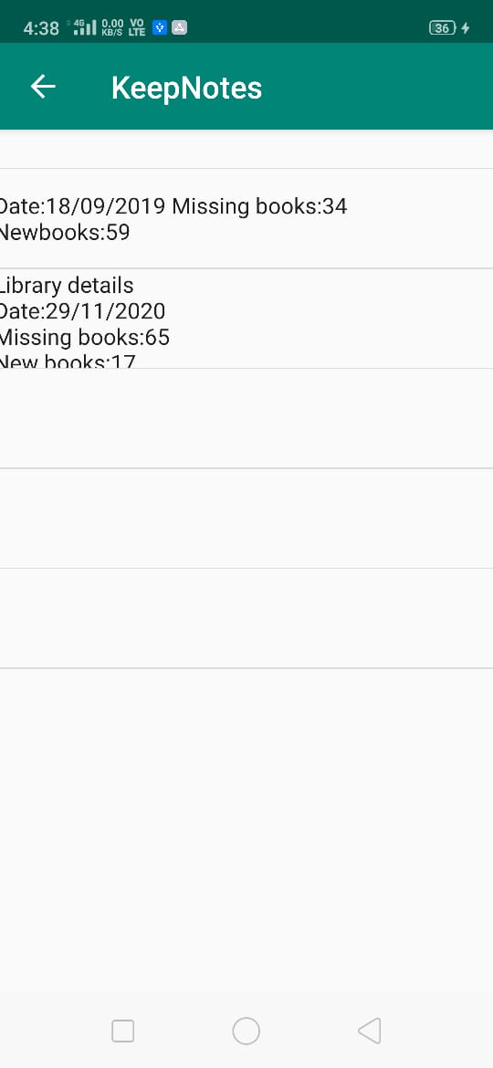
Keep Notes

Slide 29
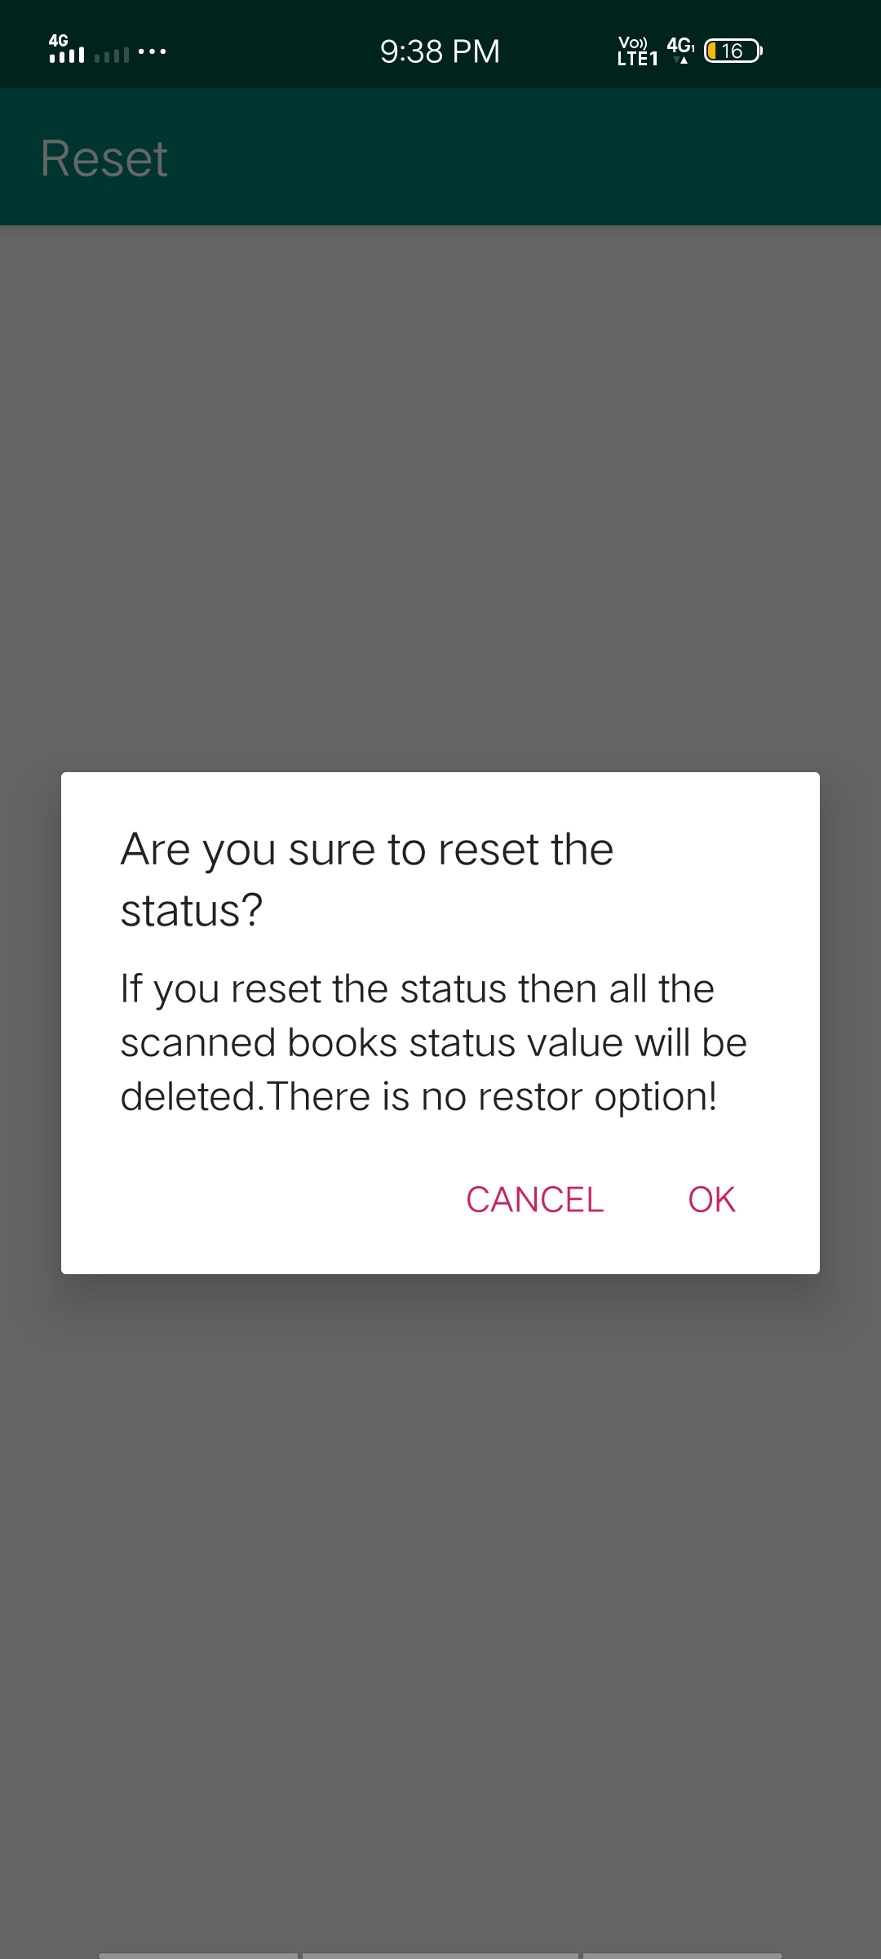
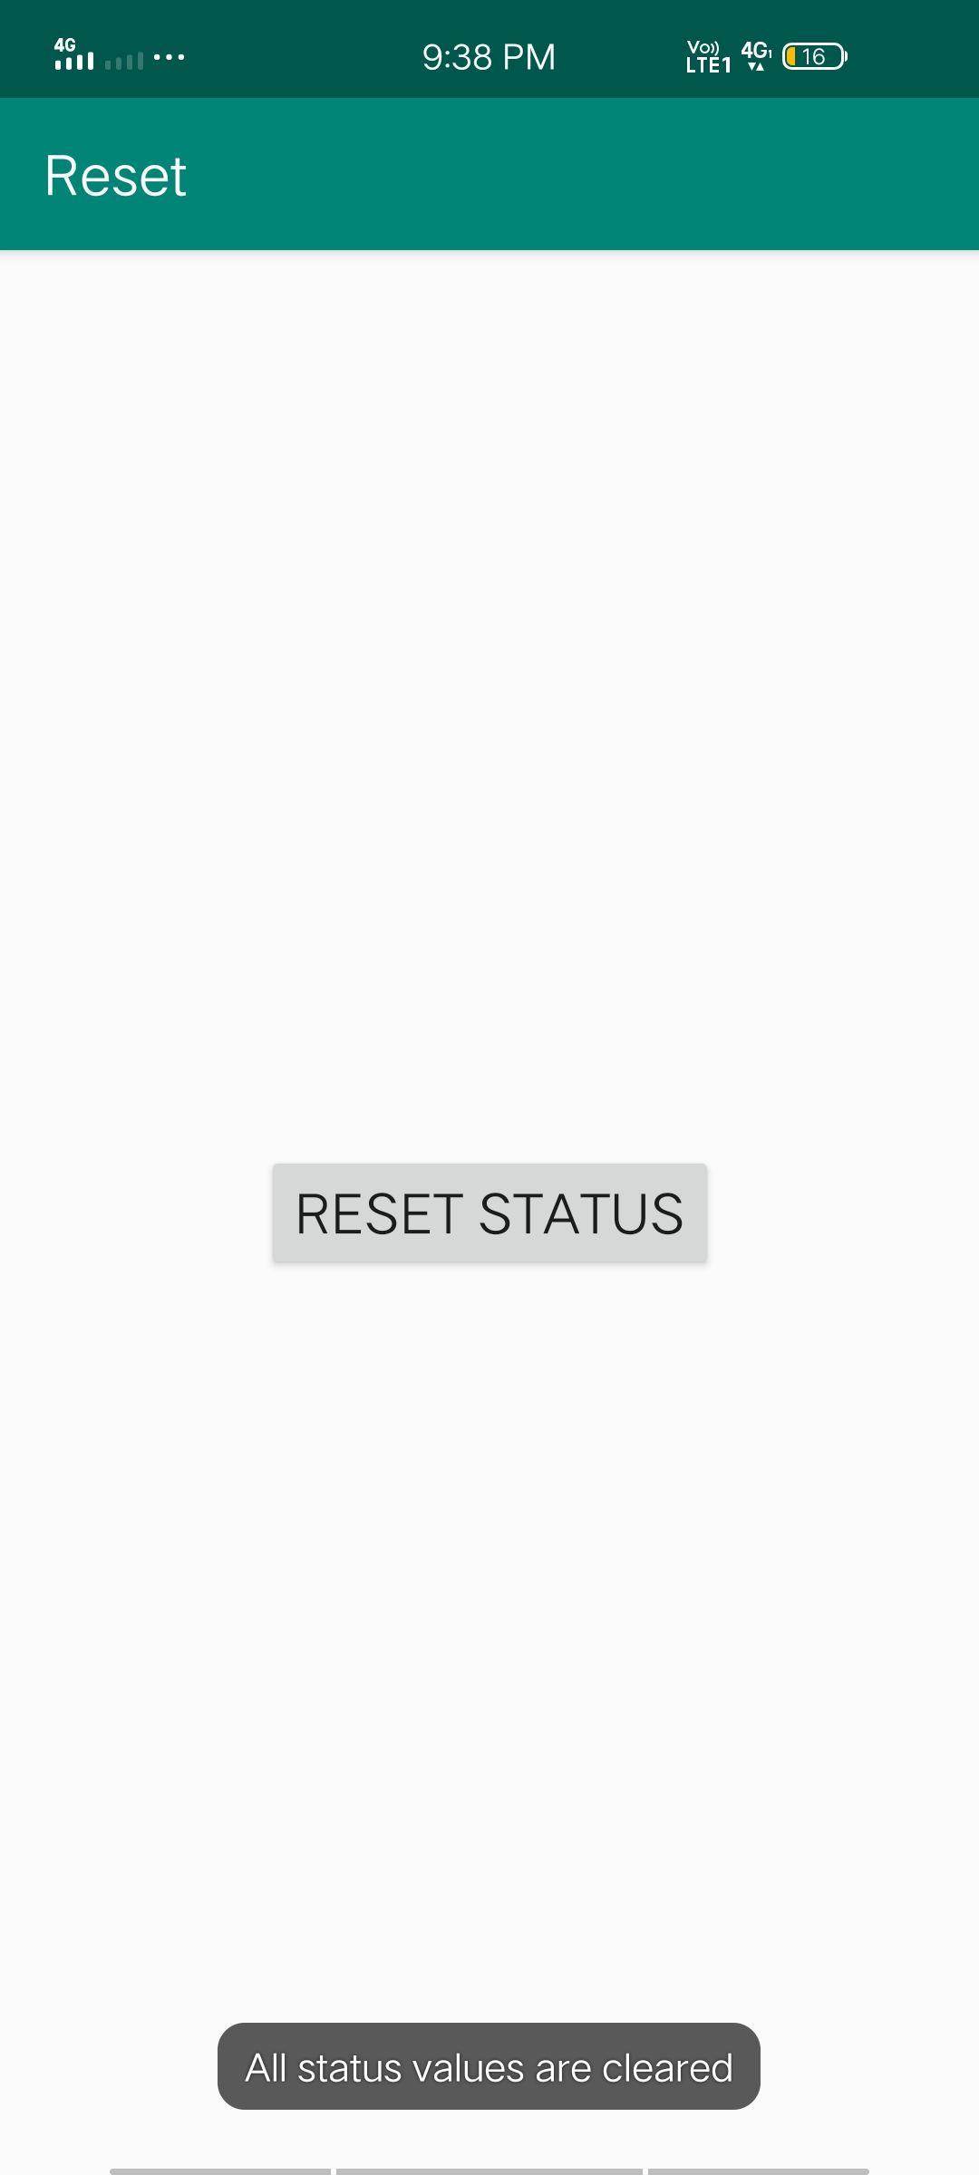
Reset Status After Completing auditing

Slide 30
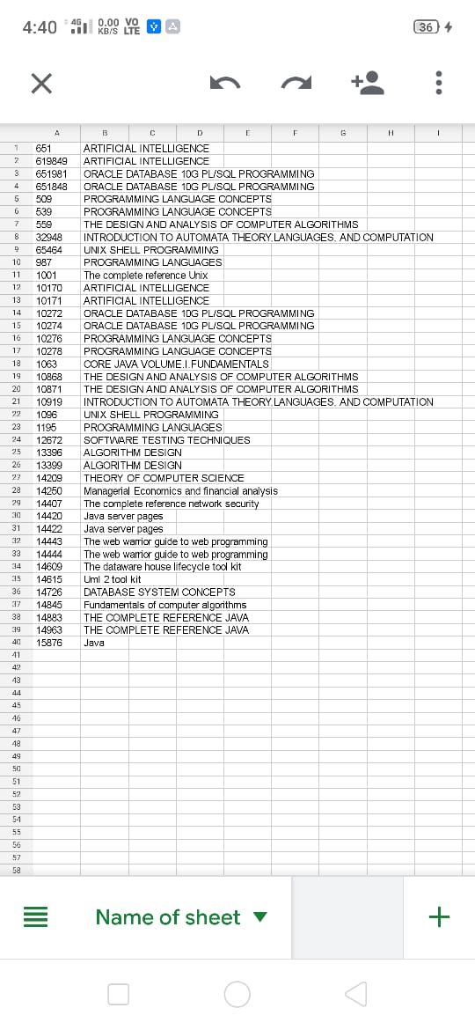
We will get report of missing books

Slide 31
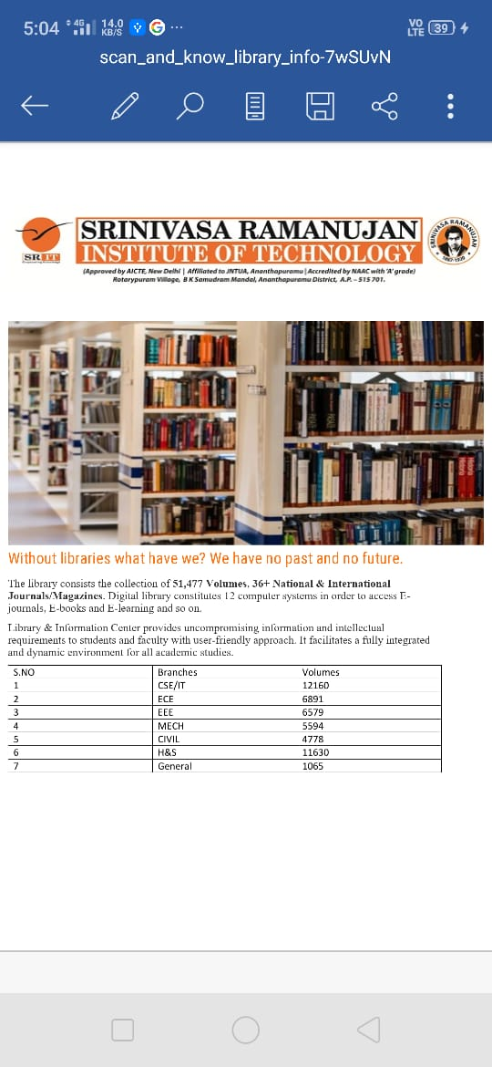
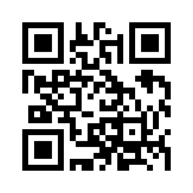
If we scan a QRCode then we will download document

Slide 32
Conclusion
Enhanced QRCode based Library Management System is an android application which helps these for auditing of books in library.Issuing and returning of books is managed and then finally we will get the report of missing books.We can note an important information within an application and stored it permanently within application. We can get library information by just scanning of QRCode .By these application the auditing is done within a short period of time.

Slide 33
References
[1] U. Narmadhaa, P.Pavithra, M.Tharuneswari, S.Sowmiya, Nagarajan, “Enhanced QR-Code Based Application For Library Management System Using Android”, International Journal on Applications in Information and Communication Engineering Volume 3: Issue 1: February
[2]Lambodara Parabhoi, Nivedita Bhattacharjya, Rupashree Dhar “Use of QR Code inLibrary” researchgate.net/publication/318259063 January 2017
[3]QRCodeGenerator:https://www.the-qrcode-generator.com/

Slide 34
Previous Questions
Review 1:
What is front end of our project?
What is backend of our project?
Tools used in our project?
Review 2:
Is there any limit for continuous scanning of books?
If any QRCode damages then how will you do?
Review 3:
Which type of QRCodes are using?
What is UiPath?
Which packages are used to generate the QRCode?

Slide 35
THANK YOU
Queries
?

